Slide 1
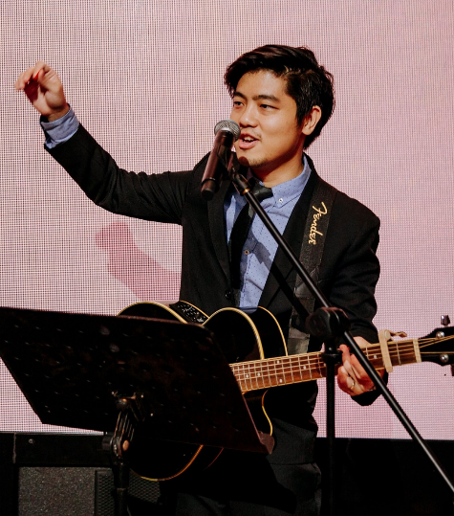
What I used to do...
Ian Chan
Research Fellow working on butterfly colours
What I want to do...
Retired Professor
2 Truths; 1 Lie...
I have piloted a plane
I have sailed a boat
I have driven an excavator

Slide 2
What I used to do...
Your Name
Your background
A picture of you doing something unexpected
or exciting
What I want to do...
Your dreams / ambitions
TEMPLATE - COPY AND PASTE this to a NEW SLIDE and fill in your own introduction
2 Truths; 1 Lie...
I have flown a plane
I have sailed a boat
I have driven an excavator

